Slide 1

Easy-Encryption
By Encryption Team Members:
Preaston Cunningham
Abdurrahmaan Baghdadi
Jacob Houssian
Daniel Botello IV
Pedro Davila

Slide 2
Necessity for the application
With a world that is heavily dependent on technology it is important that data is secured. Following the same principles given in cybersecurity training, it is important to consider the confidentiality of important information. This information can include but is not limited to Personally Identifiable Information (PII), Healthcare information, and Financial information. When handling significant information it is important to store this data in a secure manner. Our application hopes to pursue this feat in a efficient manner by providing the following services: Encryption of files, Decryption of files, a Secure Personal Information storage vault, and Saved Keys for user convenience.

Slide 3
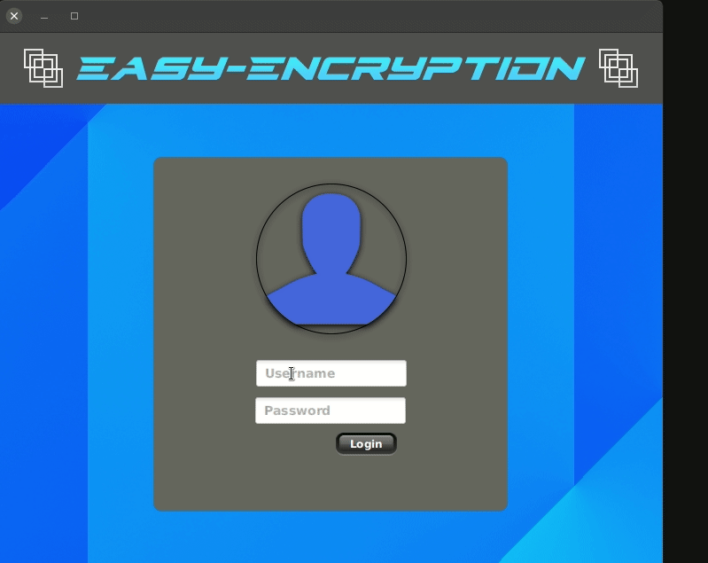
Login.fxml
Here is the log in functionality.
When a user inputs the wrong information, it will display an error prompt to the user.

Slide 4

Login.fxml (cont.)
Here is the log in functionality.
When a user inputs the correct information they are given access to the primary interface.

Slide 5
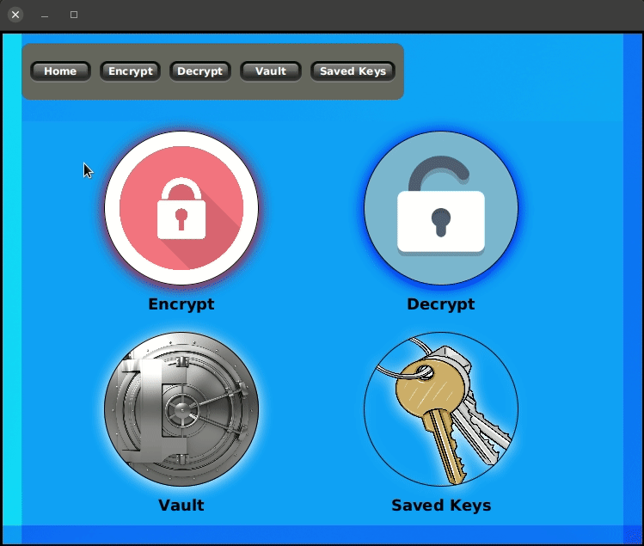
UserInteraction.fxml
The UserInteraction view is used as a home menu for the user to navigate between different views.

Slide 6
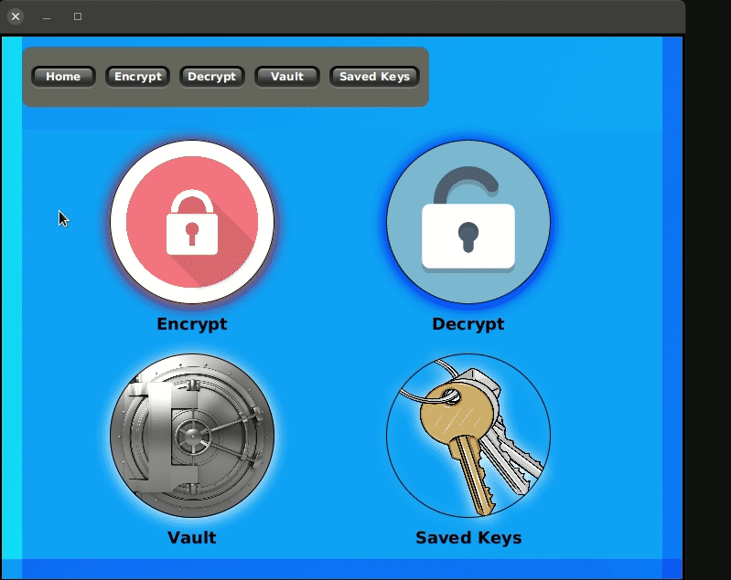
Encrypt.fxml
Here is the encryption functionality.
This will take a key and a .txt file from the user, it will then encrypt the contents of the file using the key. It will save the encrypted contents in a new file ending with .encrypted.txt.

Slide 7
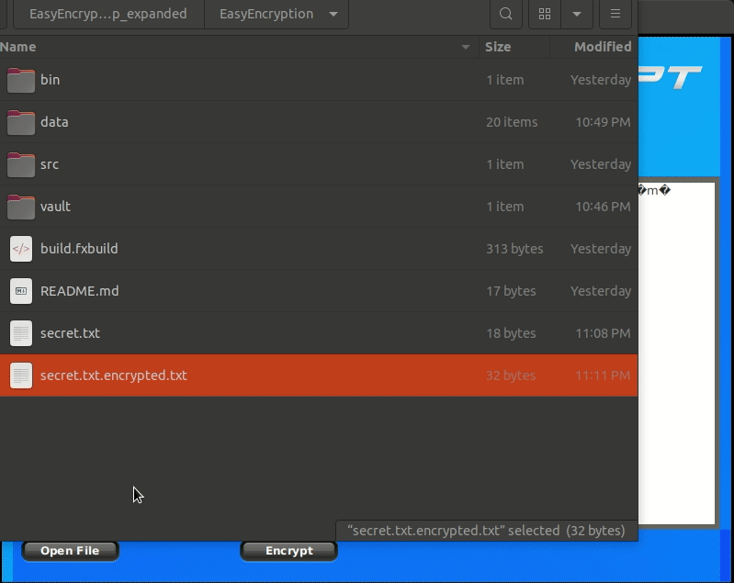
Encrypt.fxml Continued
Here is a file that was encrypted being opened. As you can see the contents of the file are not readable.

Slide 8

Decrypt.fxml
Here is the decryption functionality.
This will take a key and an encrypted file from the user, it will then decrypt the contents of the file using the key. It will save the decrypted contents in a new file ending with .decrypted.txt.

Slide 9
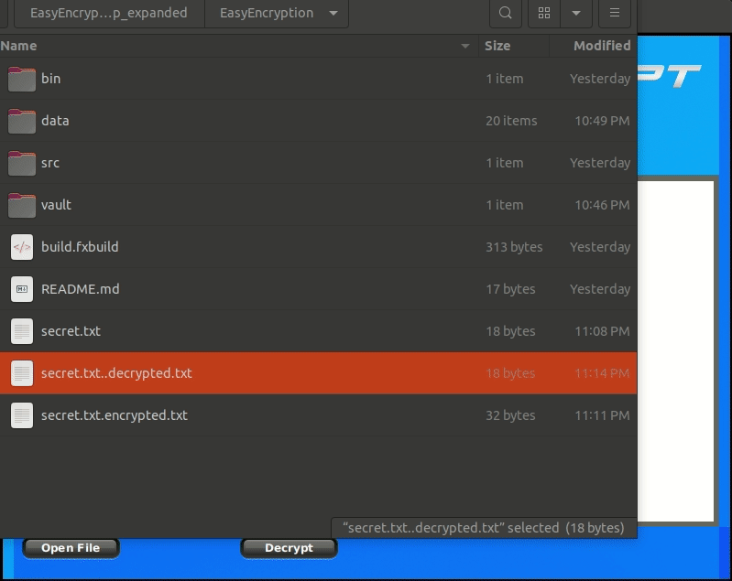
Decrypt.fxml Continued
Here is a encrypted file that was decrypted being opened. As you can see the contents of the file are readable.

Slide 10
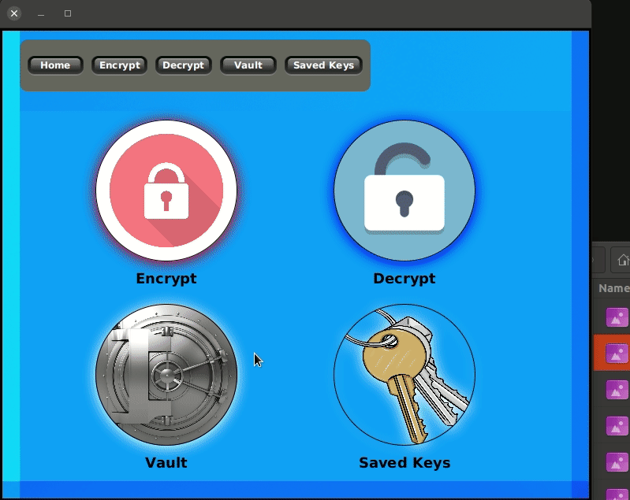
Vault.fxml
Here is our vault.
This is a text file that the user can write to within our application. When the user is logged in they will see their vault in a decrypted state. Once the user leaves the vault the vault contents are encrypted.

Slide 11

Vault.fxml
Here you can see that the contents of vault are encrypted in the vault file and decrypted while viewing in the vault. While for demo purposes there is a vaultDecrypted.txt this is not in the standard application.

Slide 12
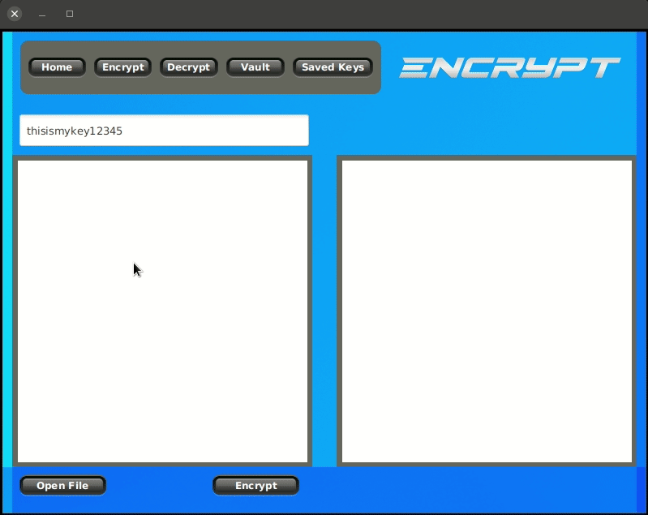
SavedKeysView.fxml
Here you can see SavedKeys.
This will save the user’s keys after they have encrypted a file.

Slide 13
Conclusion
Through the use of AES encryption method and key storage we can hope to have a lasting impact on the user convenience of security for file storage and information transfer. We also hope to encourage users on how easy it is to keep your files encrypted and save from being stolen by malicious attackers. Through this project we have learned about encryption and how to implement user friendly software for a java environment. This project has also provided practice with the use of git through github, egit, and linux git commands. We are grateful for your attendance and hope you enjoyed our project. Keep your data safe!!!!!

